Slide 1
Used Cars Price analysis
Presented by:
Myadam Akshay

Slide 2
Project Objective:-
The objective of the “Used Cars Price Analysis” project is to conduct an in-depth analysis of the pricing variations among different Car Brands in the India.
To analyze Car data across India to uncover customer preferences, optimize pricing strategies, and provide actionable market insights that will help improve brands, marketing, and overall competitiveness in the Indian Cars Website’s."
The data is taken from “CARS 24” website by using some python webscrapping to extract the data in the form of datasets.

Slide 3
Main Agenda
1)Web Scrapping to collect the data
2. Data Cleaning and Manipulation
3. Visualization and Analysis on various factors like Price, Finance, Special feature,Owner….etc…. to analyze above problem statements.
An in-depth exploration of web scraping and data visualization using python on “CARS 24” website and retrieve Cars data from tier 1 cities from country. Learn the power of extracting and visualizing data for insightful analysis.

Slide 4
Tools used:-
Software Requirement:-
1)Python(Jupyter notebook)
2)Power bi
3)Excel
Main Software Libraries:-
1)Pandas
2)Beautiful Soups
3)Requests
Note : Here we are not using NumPY because it is primarily used for numerical computations and here we are focusing on WebScrapping and Data Manipulation using above libraries

Slide 5
INTRODUCTION:-
Overview of project:-
Discover the main objectives and scope of Project Cars Analysis for web scraping and Data cleaning , Data Modelling , Data preprocessing In Python and data visualization in Power bi.
Importance of Analyzing Car’s Data:-
Analyzing Car’s Data is crucial for various reasons, and it can provide valuable insights for both Customers and Employes.
Importance of web scraping, data preprocessing and data visualization:-
Exploring the web scraping, data preprocessing and data visualization are critical for obtaining and understanding valuable data.

Slide 6
Webscrapping:-
Step 1:- IMPORT LIBRARIES
import requests # HTTP requests :-web scraping or interacting with web
import pandas as pd # Data manipulation using pandas.
from bs4 import Beautiful Soup # HTML parsing using BeautifulSoup pulling data out of HTML and XML files and searching and modifying phrase tree

Slide 7
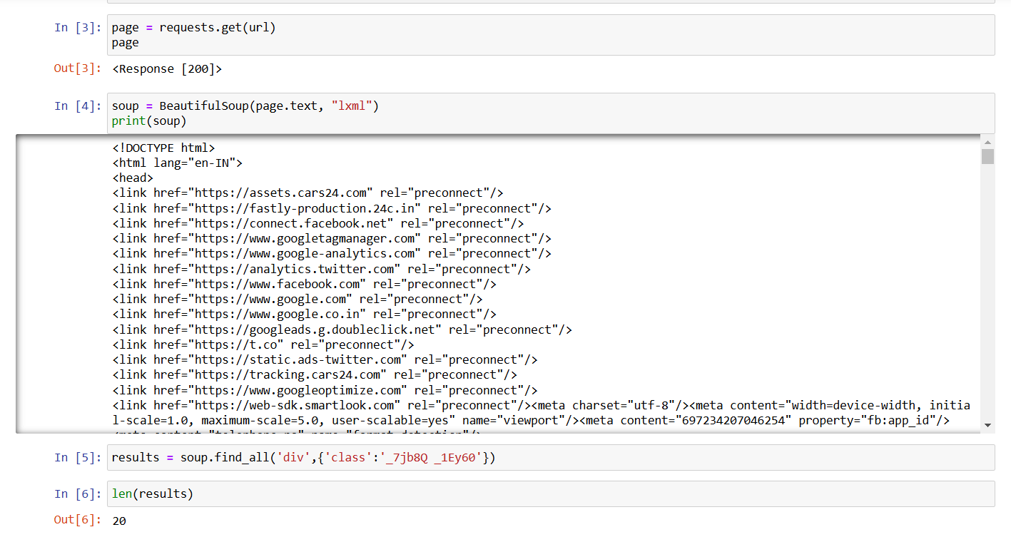
.
STEP 2:- URL
Web url = https://www.cars24.com/buy-used-cars-hyderabad/
STEP 3:- Scraping HTML Content Using BeautifulSoup

Slide 8
.
Get the Website Data: It uses requests to download the content of a webpage (like copying everything you see on a website).
Organize the Content: The BeautifulSoup library organizes the messy website code into a clean, easy-to-read format.
Look for Specific Sections: It searches the webpage for all the boxes (divs) that have a specific name (a class called _7jb8Q _1Eyr60).
Count Them: It counts how many of those boxes were found, and in this case, there are 20.
Understand the Website: This helps find and use the parts of the website you actually need!

Slide 9
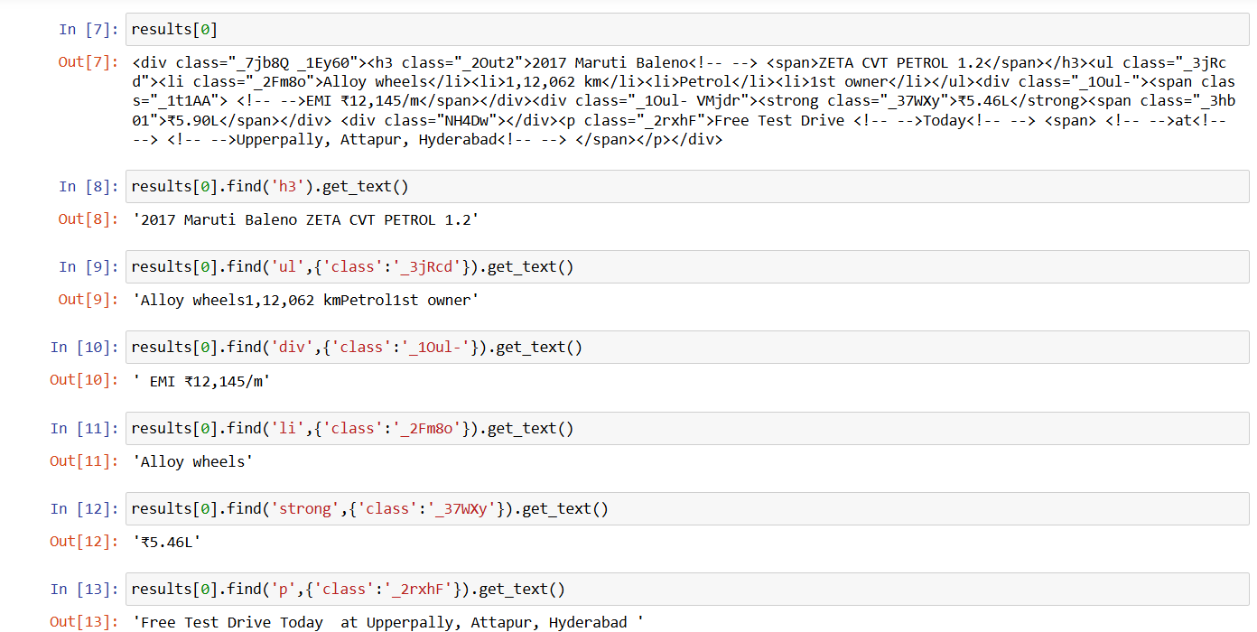
.
STEP 4:- Extracting Specific Car Details from Web
Accessing Data: results[0] selects the first car listing from the scraped data.
Extracting Car Details: find('h3') retrieves the car's name, which is "2017 Maruti Baleno ZETA CVT PETROL 1.2".
Getting Features: find('ul') lists features like "Alloy wheels, 1,12,062 km, Petrol, 1st owner".
Extracting Price and EMI: find('strong') fetches the price ("₹5.46L") and find('div') gets EMI details ("₹12,145/m").
Location Info: find('p') extracts the location of the car, such as "Upperpally, Attapur, Hyderabad".

Slide 10
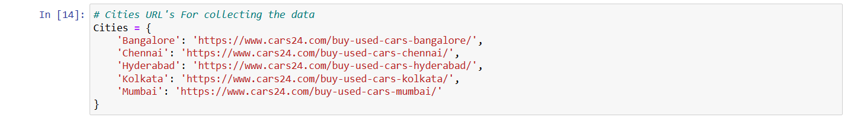
.
STEP 5:- Collecting Data City-Wise from Cars24 Link
This code snippet defines a dictionary named Cities that maps city names to their respective
URLs for collecting used car data from the Cars24 website.

Slide 11
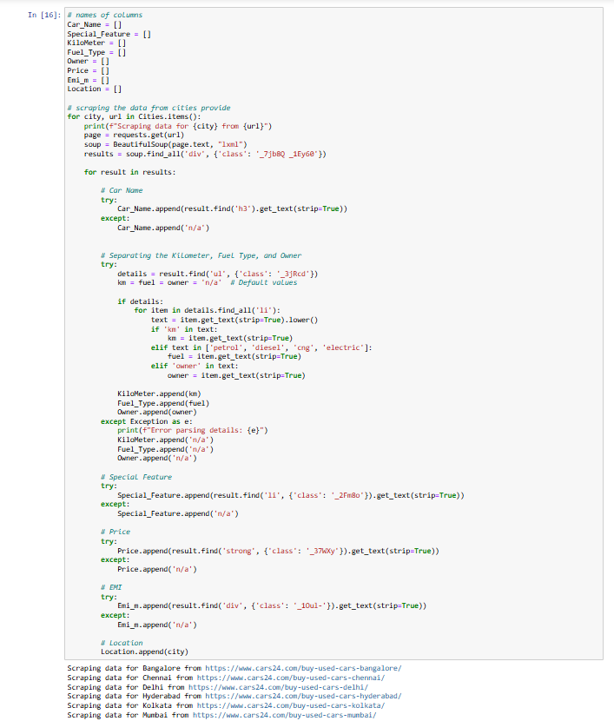
.
STEP 6:- Collecting Data City-Wise from Cars24 Link
Initialize Lists: Sets up lists to store car data (e.g., Car_Name, KiloMeter, Fuel_Type, Price, etc.)
Iterate Through Cities: Loops through Cities dictionary, fetches the webpage for each city, and finds all car listings using BeautifulSoup.
Extract Data for Each Listing: Car name, kilometers, fuel type, owner, special feature, price, EMI, and location are extracted from specific HTML elements.Default values ('n/a') are used if any information is missing.
Handle Errors: Uses try-except blocks to prevent crashes and append 'n/a' when elements are not found or errors occur.
Store Results: Appends extracted data to corresponding lists, which can later be converted into a structured format like a DataFrame.
NOTE : We have separated Kilometer, Fuel_type, Owner by using “if-elif”

Slide 12
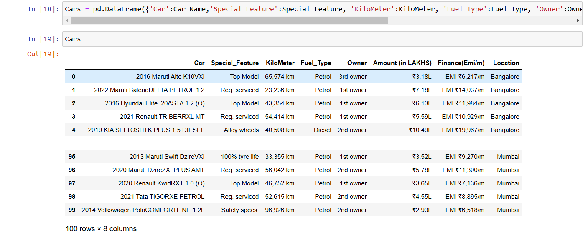
.
STEP 7:- Creating a DataFrame of Used Car Data
Above code line creates a Pandas DataFrame named "Cars" to store the collected used car data. The DataFrame includes columns for the car name, special features, kilometer reading, fuel type, owner, amount in lakhs, finance EMI, and location.

Slide 13
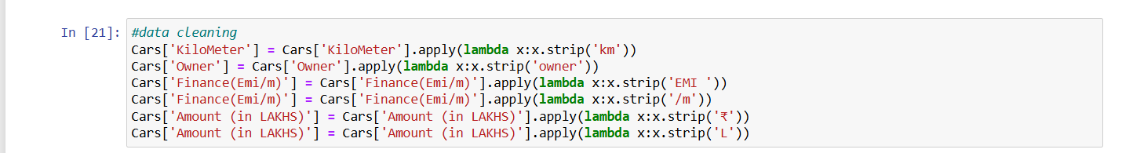
.
STEP 8:- Data Cleaning
This Python code snippet demonstrates a crucial step in data preprocessing for a used car price analysis project.
By utilizing the apply() method with lambda functions, the code efficiently cleans the "Cars" DataFrame, removing extraneous characters such as "km", "owner", "EMI", "/m", "*" and "L" fromspecific columns.
This data cleaning step is essential to ensure data consistency and accuracy, which are critical for reliable analysis and subsequent modeling tasks. Clean data enables accurate price predictions, insightful market trend analysis, and informed decision-making for both buyers and sellers in the used car market.

Slide 14
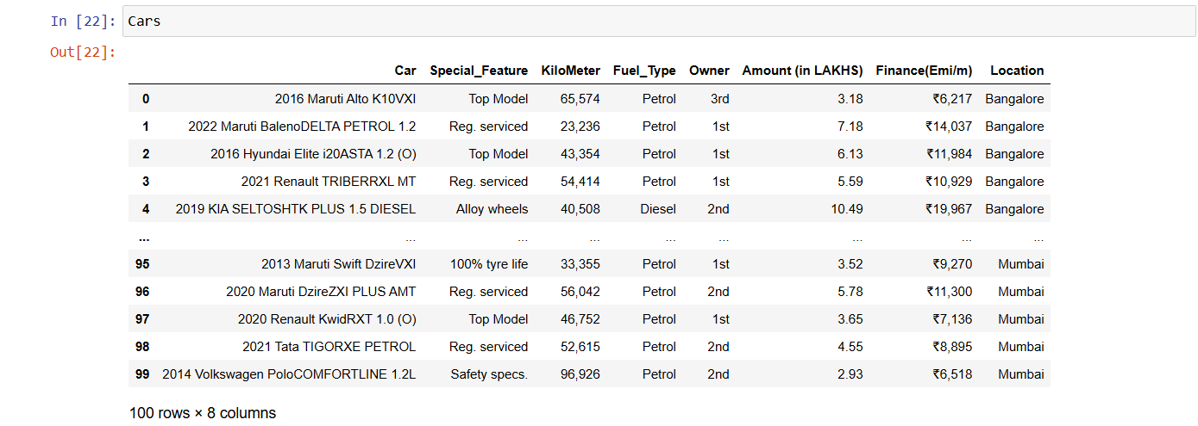
Output:-

Slide 15
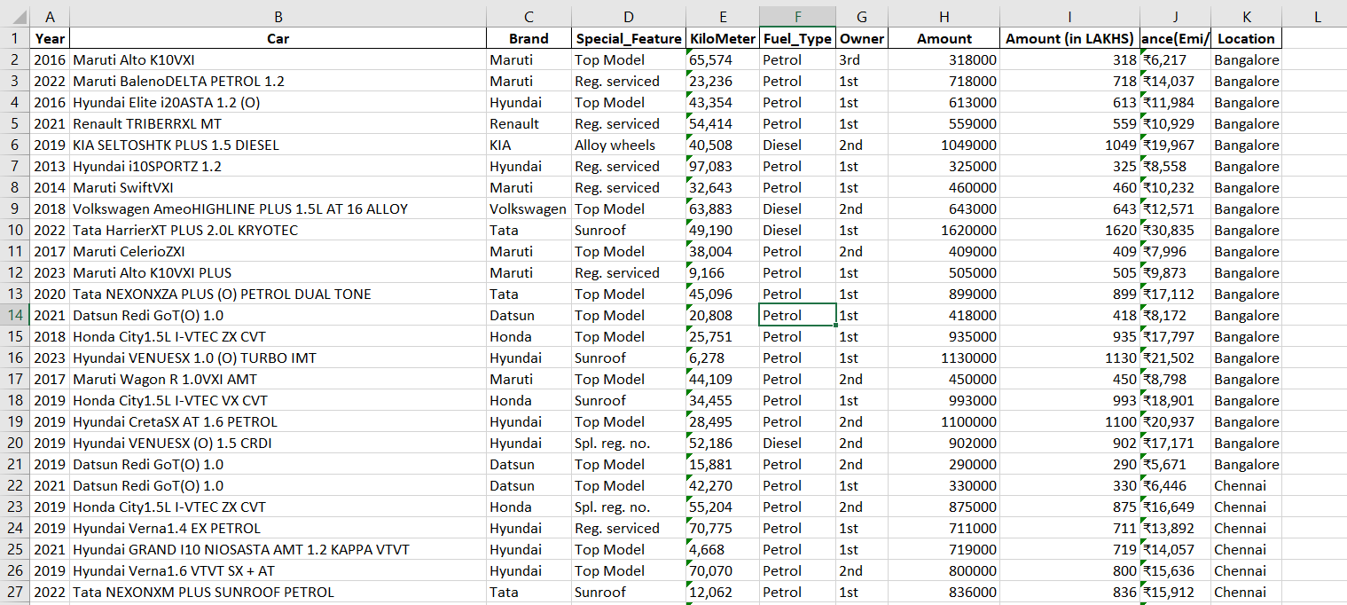
.
Created Excel File and Saved

Slide 16
Data manipulation:
Data Manipulation is the process of changing or adjusting data to make it more organized and easier to read.

Slide 17
.
Preprocessing:-
In excel 1st I have Delimited the Car column to get the Year column
2. Data Cleaning
Remove Duplicates: Identify and remove any duplicate rows in your dataset.
Handle Missing Values:
Remove Rows: If missing data is minimal and not crucial, consider removing rows with null values.
Replace Missing Values: Use the “Replace Values” feature to fill missing data with a default value, mean, median, or custom logic.
3. Data Transformation
Change Data Type
Rename Columns: Rename columns to more descriptive names that align with your analysis.

Slide 18
.
4. Filtering and Sorting
Filter Rows: Remove unnecessary rows by applying filters (e.g., removing data outside of a specific date range).
Sort Data: Sort the data based on specific columns to organize it in a meaningful way.
5. Save and Load data in Power Bi
Once all preprocessing steps are complete, save excel file and load the cleaned and transformed data into Power BI for analysis.

Slide 19
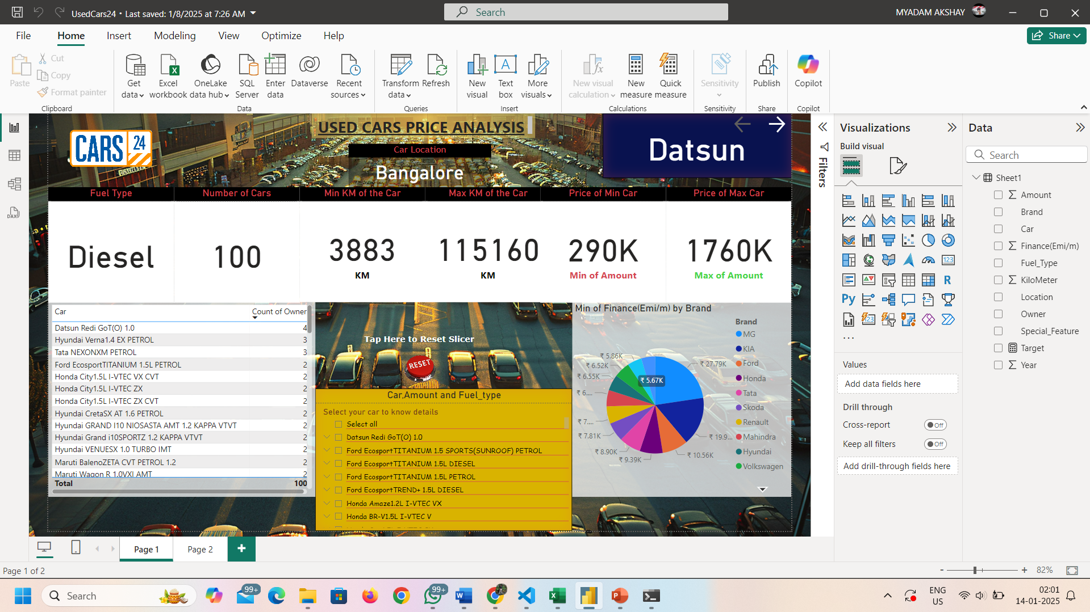
.

Slide 20
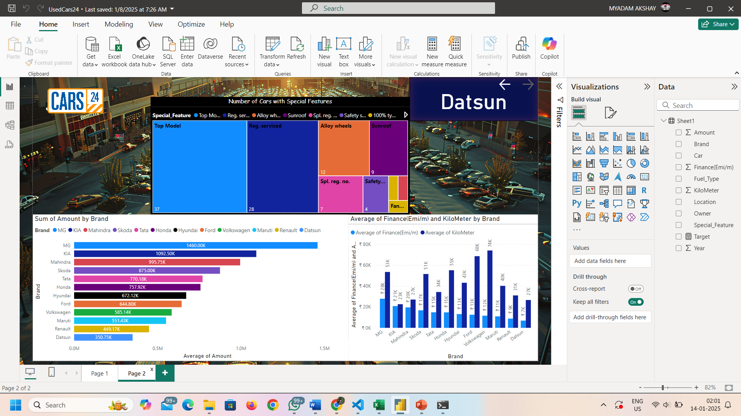
.

Slide 21


